Slide 1
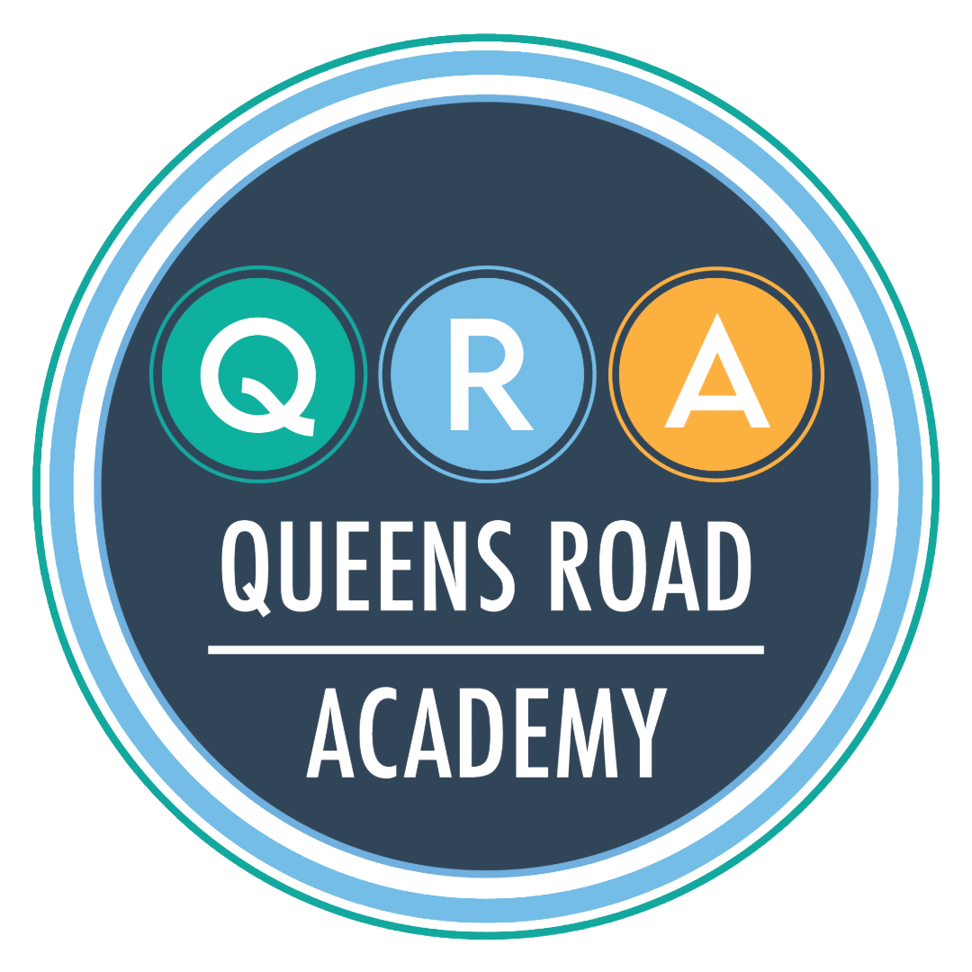
Teaching and Learning

Slide 2
How do we do it?
What does a learning sequence look like?
What does a lesson look like?
What if my child finds something difficult?
What if a child has SEND?

Slide 3
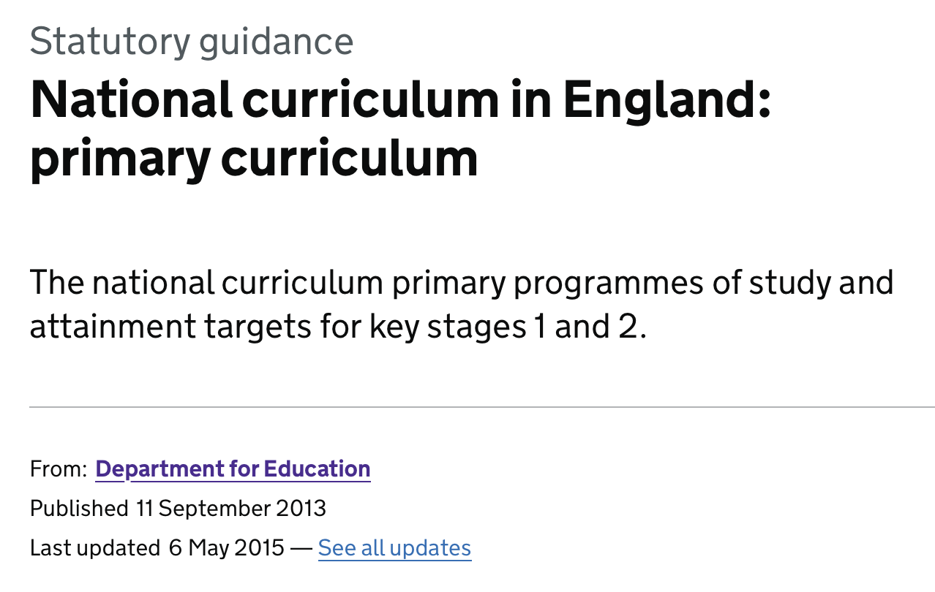
Our starting point

Slide 4
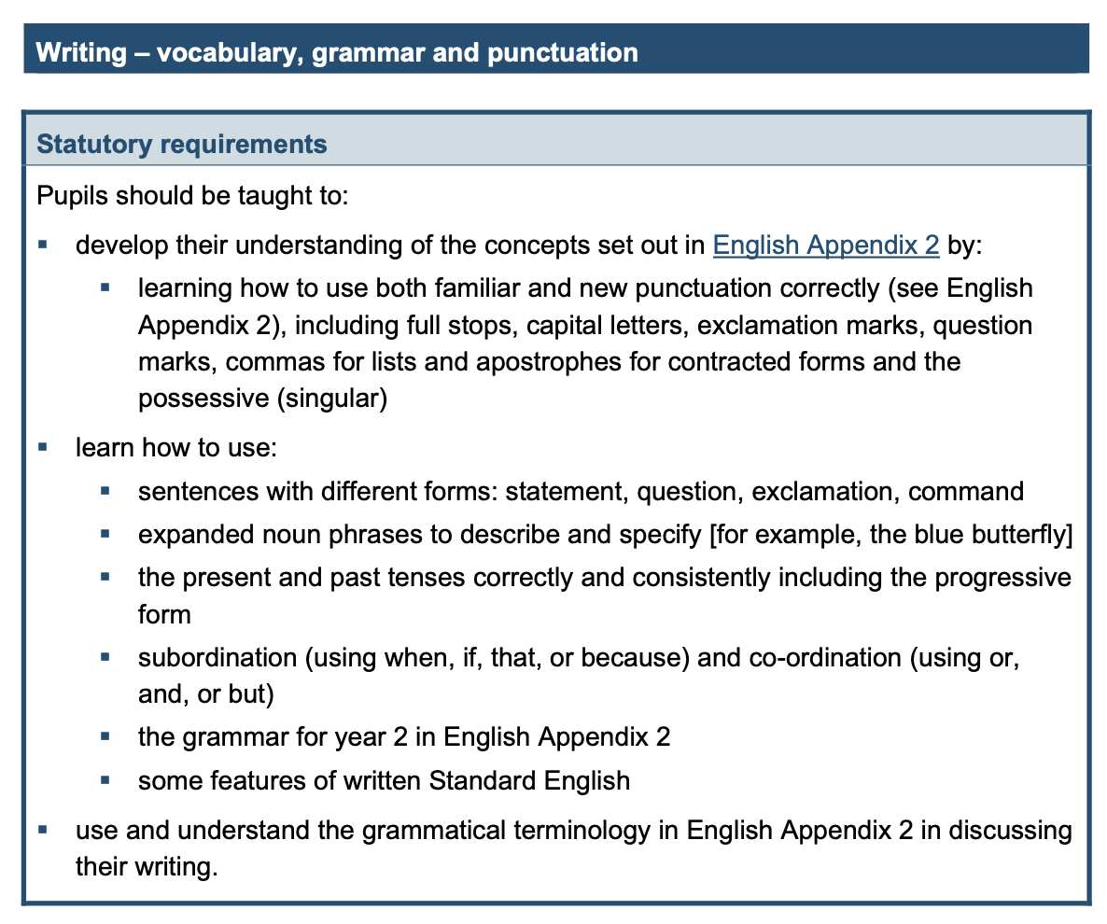
What the National Curriculum looks like

Slide 5
From there…
We have an individualised curriculum which builds upon the National Curriculum, aligned with HCAT.
Key concepts, principles and themes have been developed from the National Curriculum into a range of progressive knowledge and skills.
The curriculum is carefully sequenced so that knowledge and skills build over time.

Slide 6
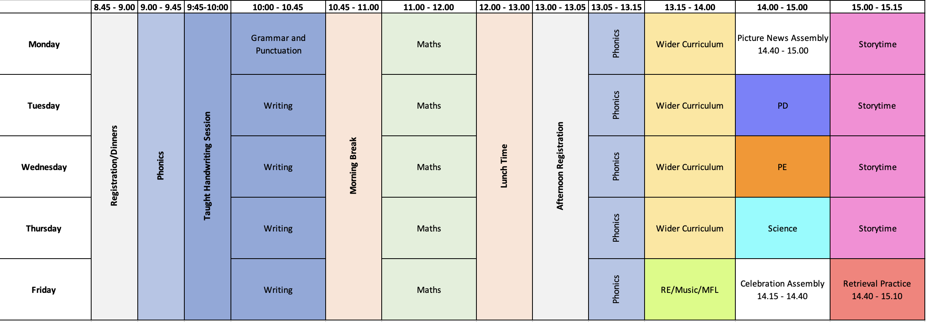

Slide 7
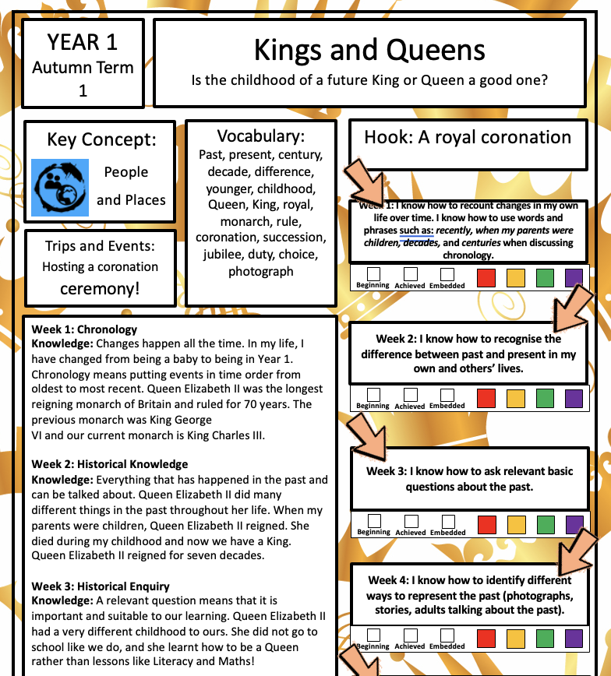
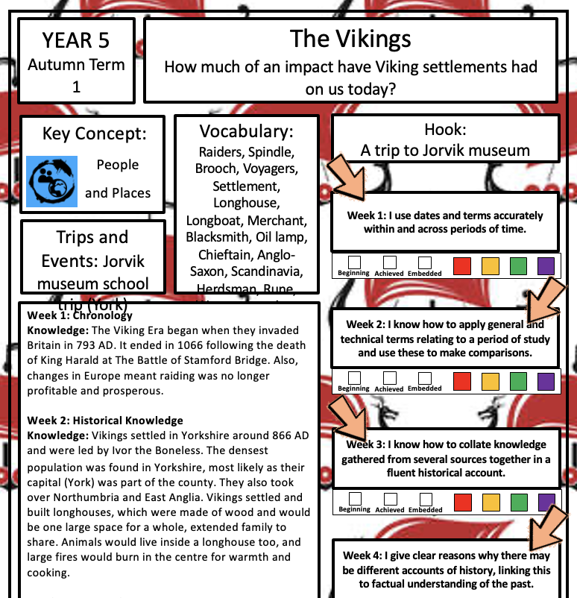
What does a sequence of learning look like?

Slide 8
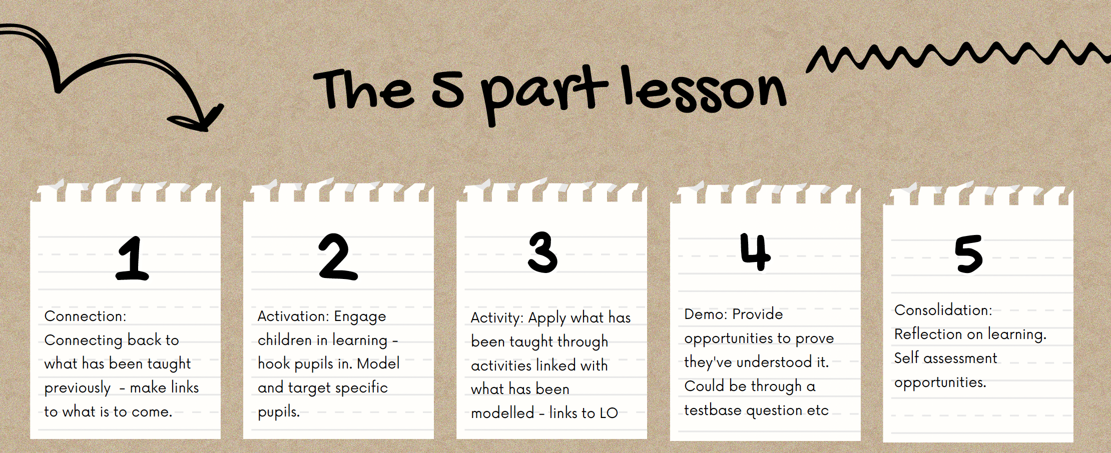
What does a lesson look like?

Slide 9
What if a child finds something difficult?
We use a method of adaptive teaching and learning.
Teachers do not assume that a child will always ‘get’ the learning first time.
Teachers must use their knowledge of what a child can and cannot do at any moment to improve their understanding.
We pitch learning in the ‘Zone of Proximal Development’.

Slide 10
What if a child finds something difficult?
We use:
Scaffolding – for example, we give children more resources through which they can access learning. Concrete/Pictorial/Abstract. Breaking learning into manageable steps.
Differentiated resources – different levels of challenge depending on task.
Flexibility; re-teaching and re-modelling.

Slide 11
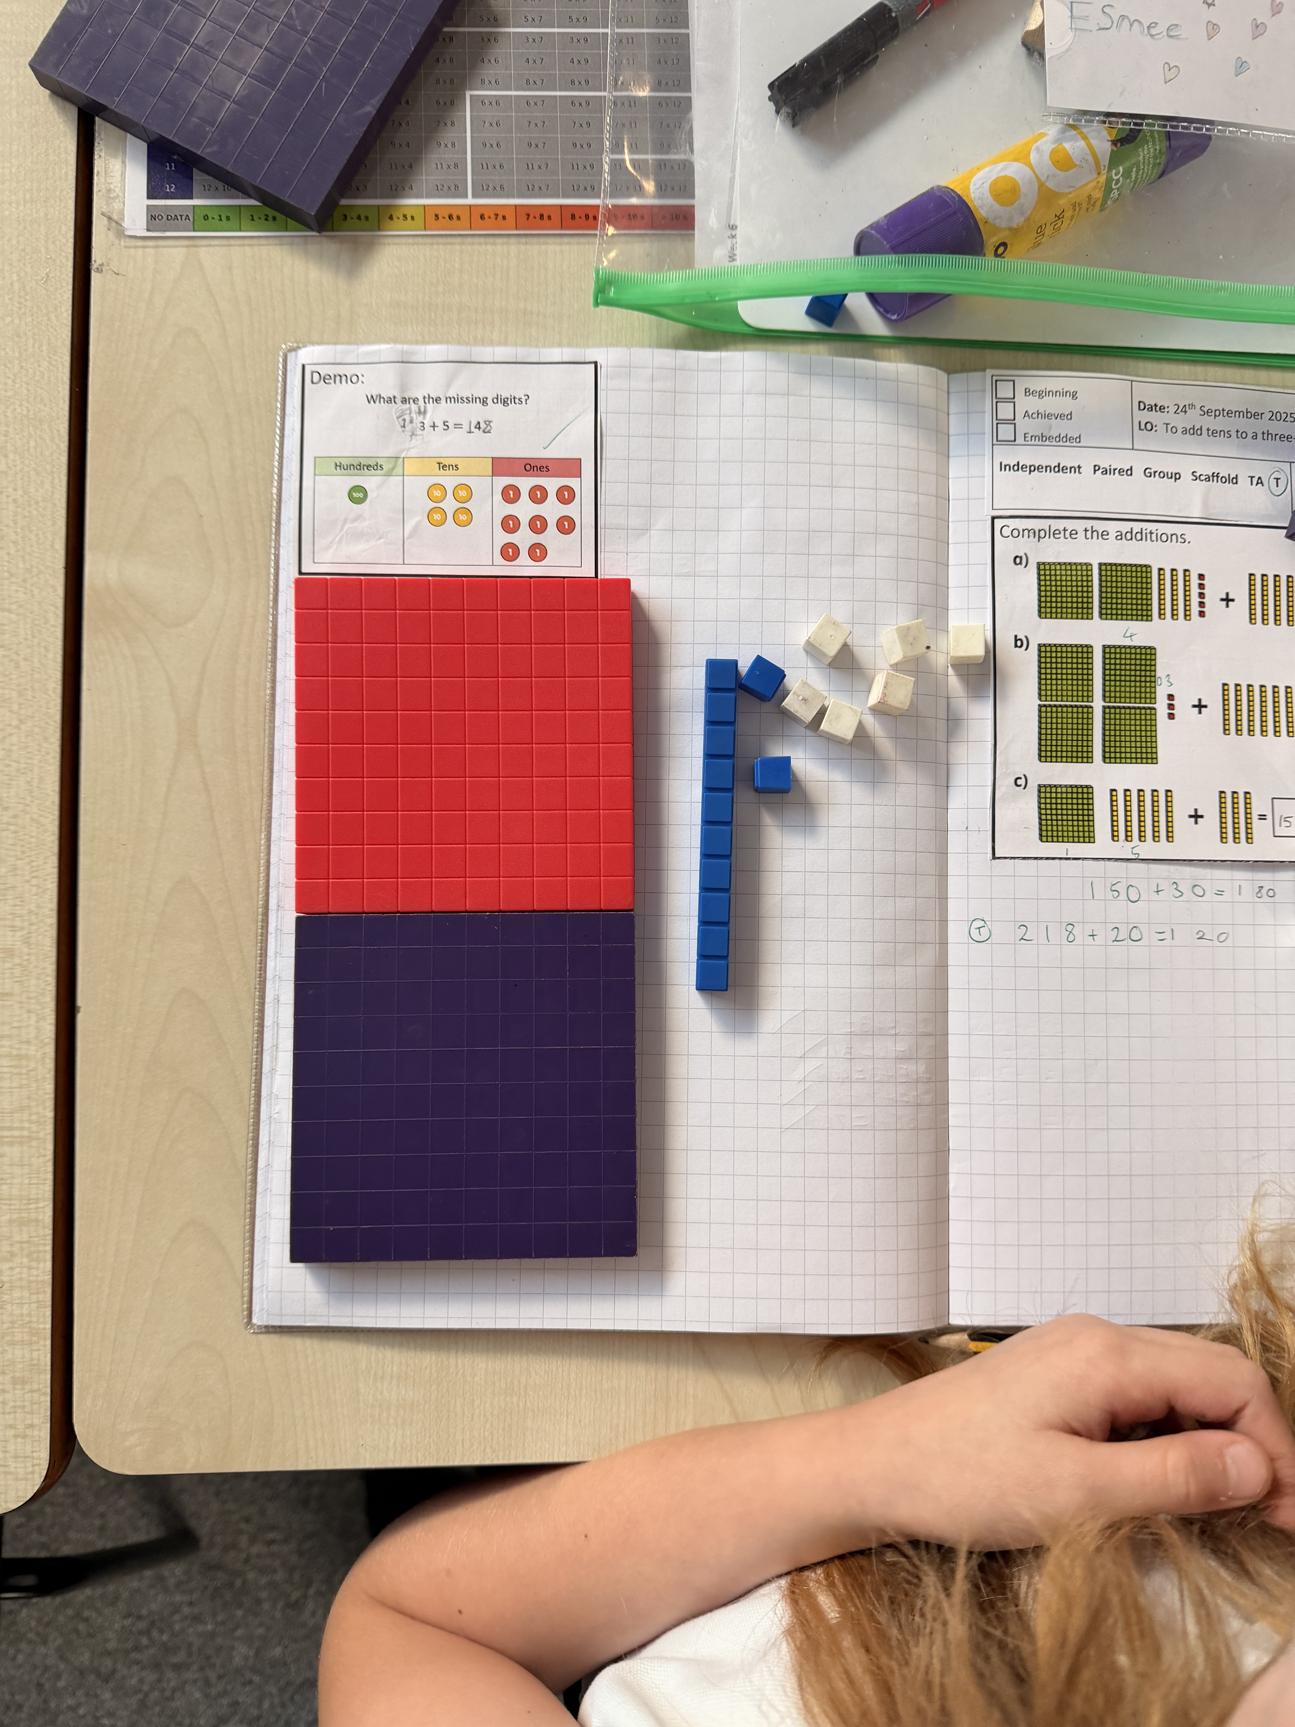
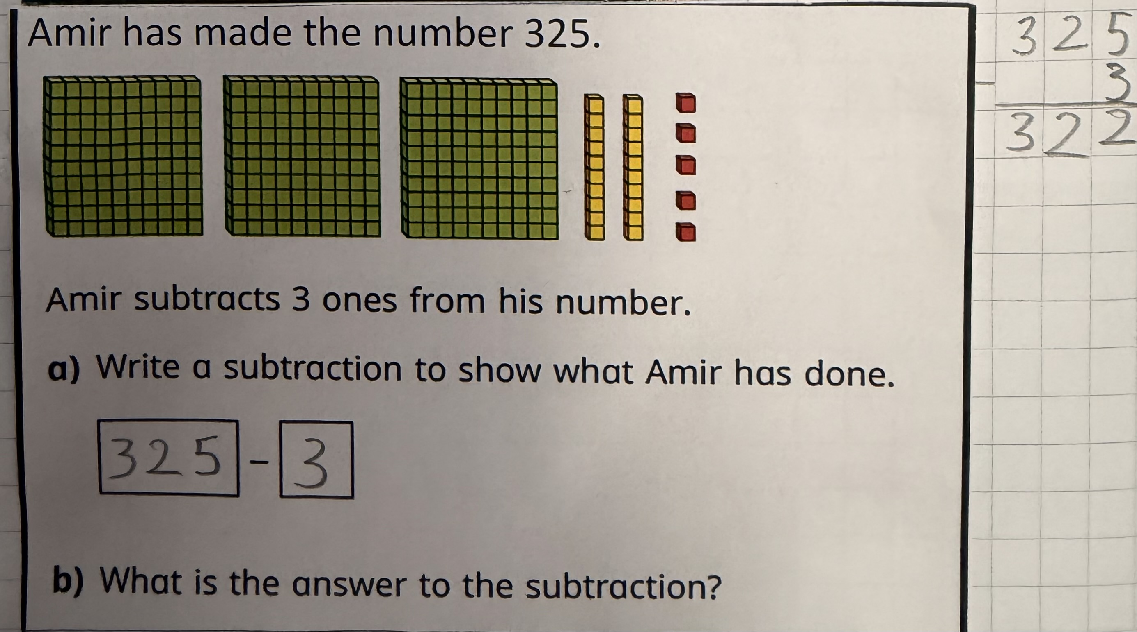

Slide 12
What if a child has SEND?
The adaptations chosen often depends on the specific learning need.
However, good practice includes…

Slide 13
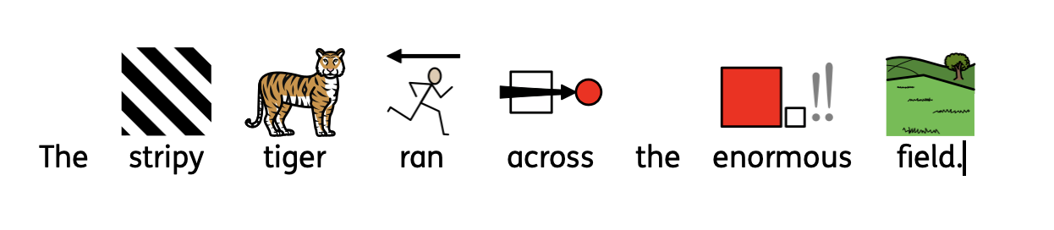
The use of visuals to support understanding

Slide 14
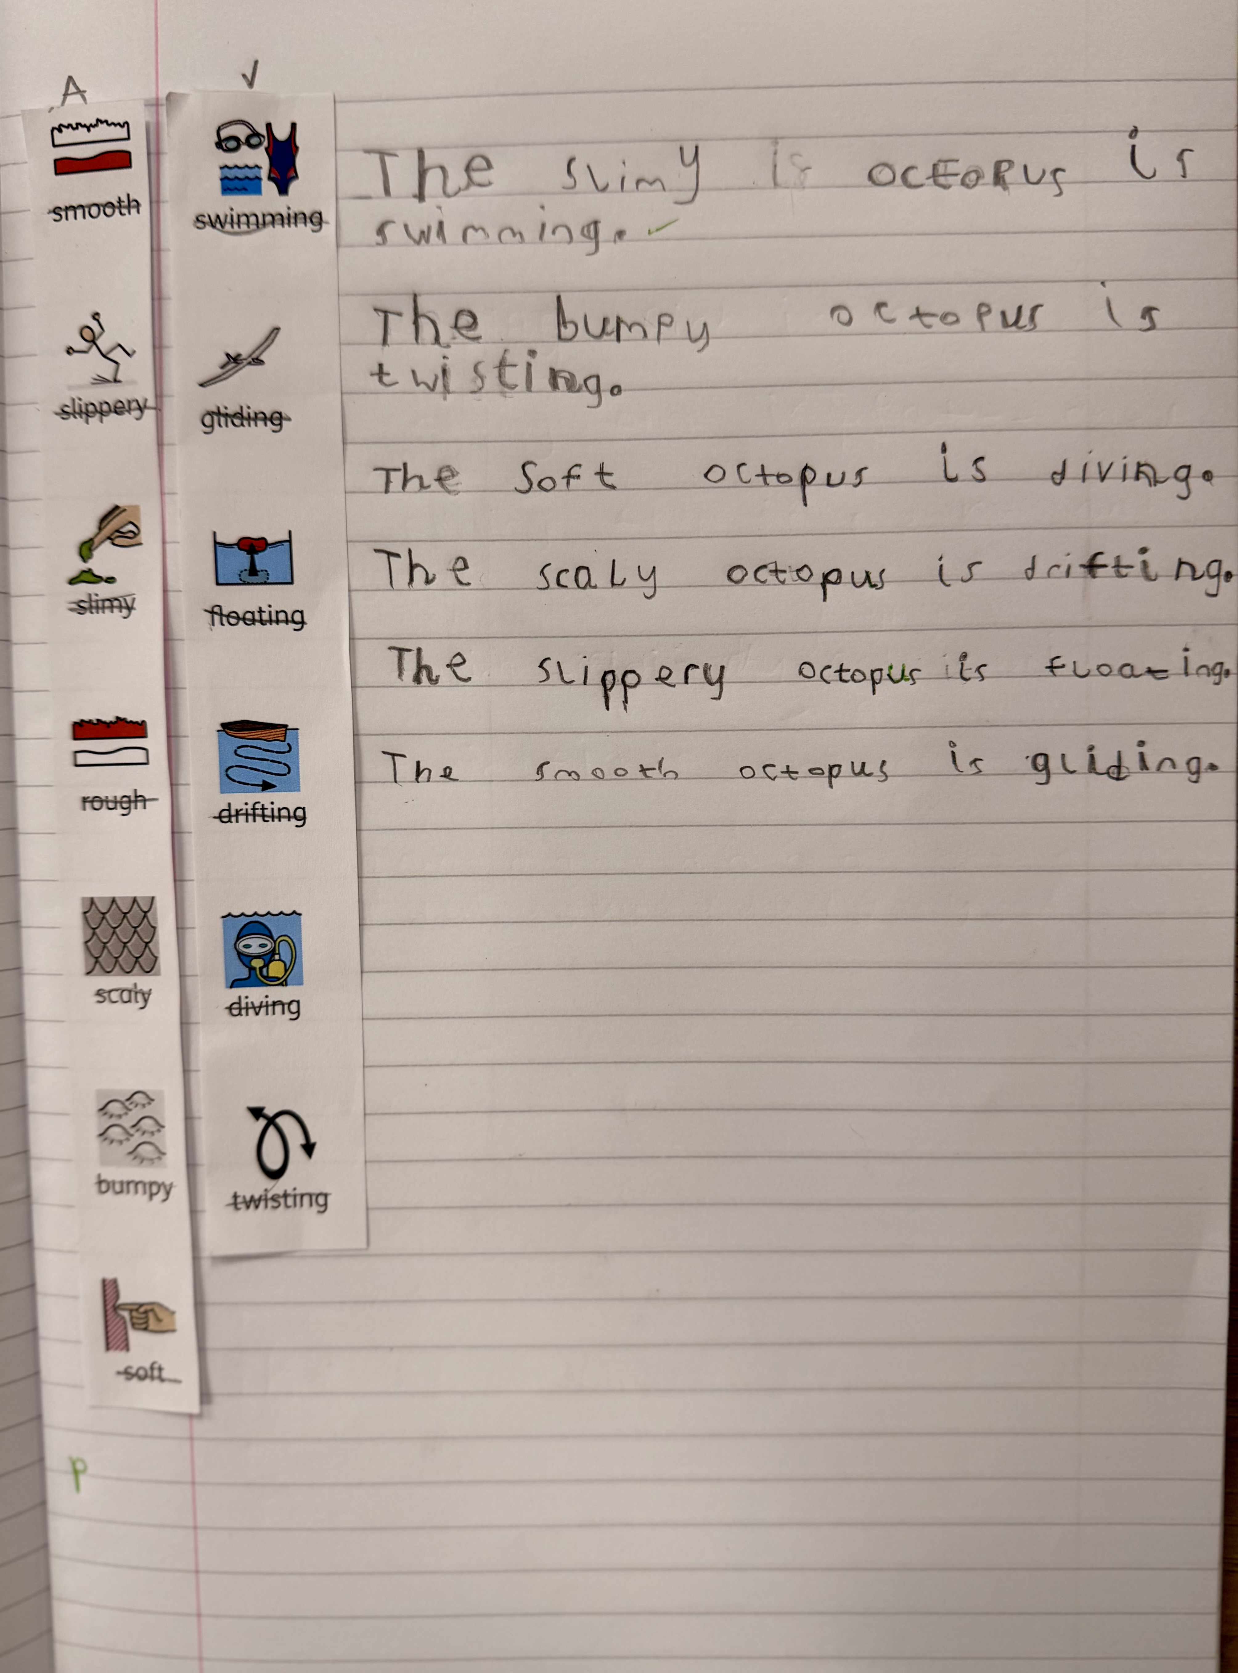

Slide 15
Environmental adjustments
Visual timetables and ‘now and next’ boards to show the day's structure
Clearly labeled resources and designated spaces for different activities
Movement breaks or fidget tools for students who need sensory input

Slide 16
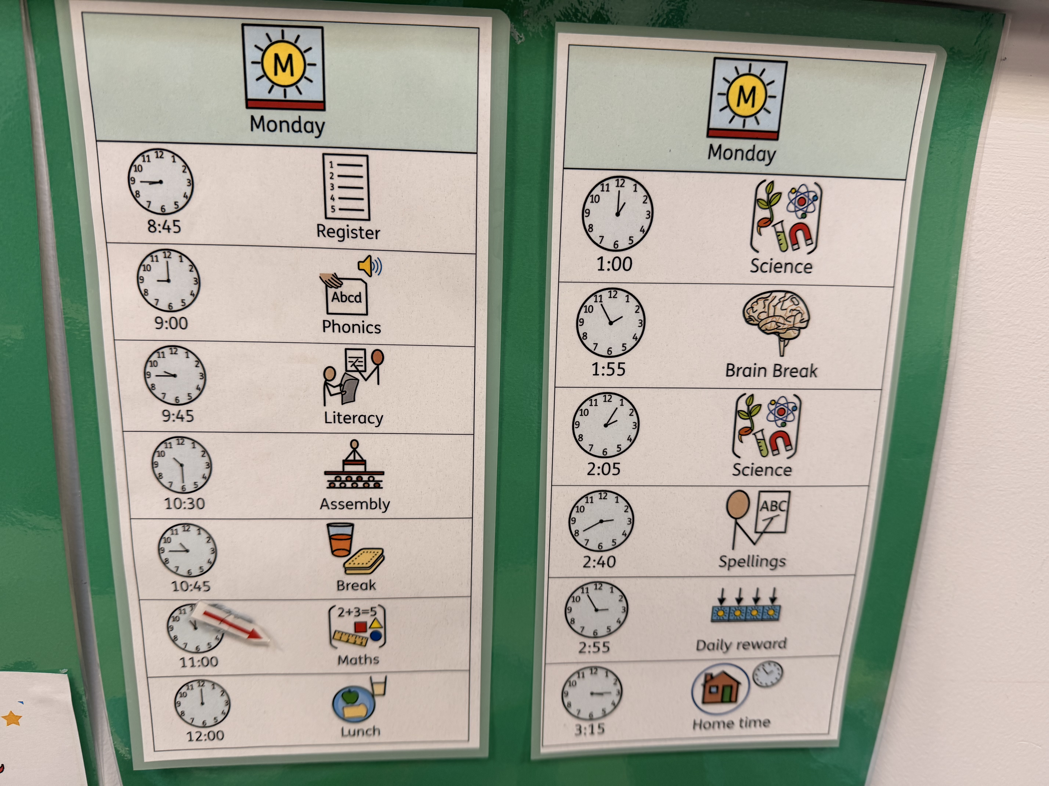
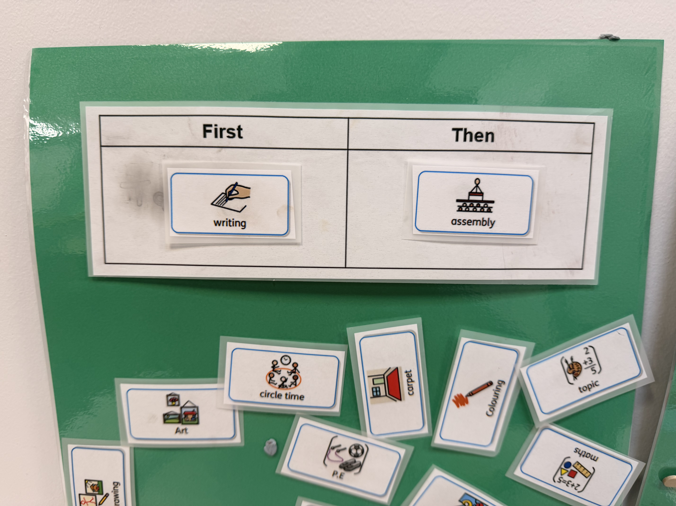

Slide 17
Task adjustments
Reducing the quantity of work while maintaining the same learning objective.
Providing alternative recording methods (drawing, photos, verbal responses)
Step-by-step task breakdowns with checklists
Use of concrete materials and manipulatives, especially for abstract concepts

Slide 18
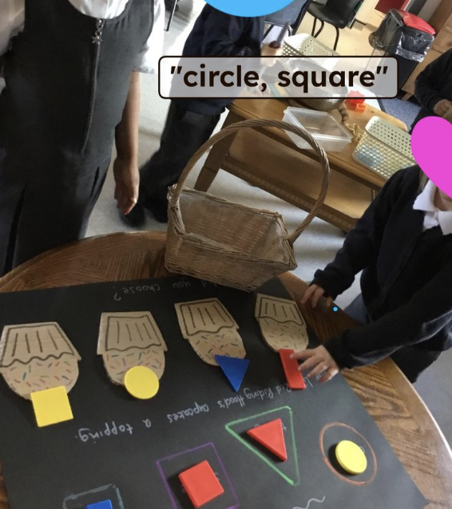
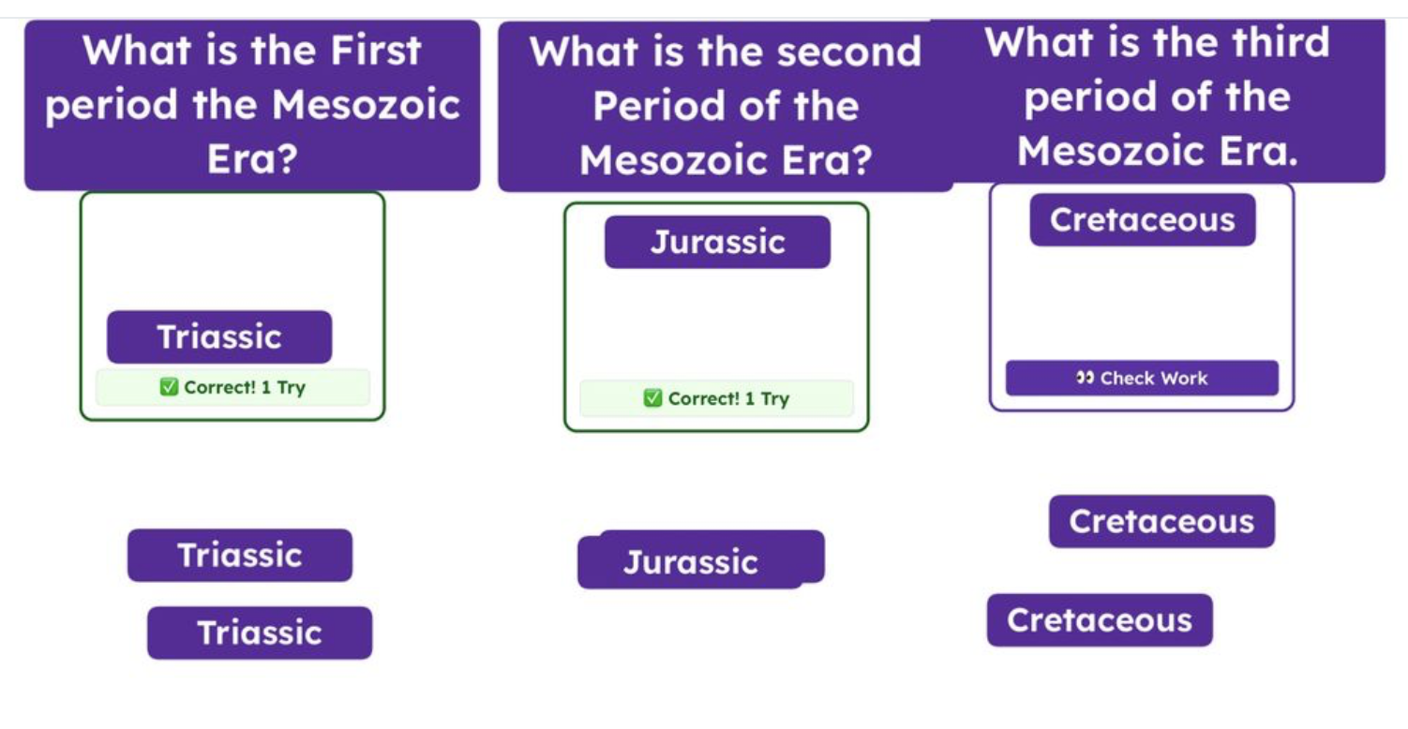

Slide 19
Teaching and Learning at QRA is…
Central to what we do. Good teaching and learning prepares children in every way possible. Good teaching and learning impacts attendance, behaviour, and pupil wellbeing.
Deliberate and intentional. Nothing is left to chance!
Non-negotiable. High quality teaching and learning is secondary only to children being safe and happy.
Always a priority. Teachers are on a consistent cycle of professional development to ensure that their practice is as strong as it can be at all times.

